Slide 1
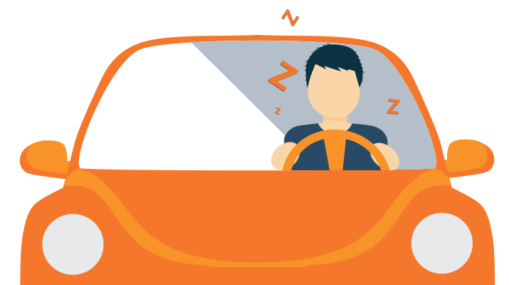
SLEEPY DETECTION
Submitted by –
RAHUL KUMAR
IVY PROFESSIONAL SCHOOL

Slide 2

OBJECTIVE
According to NHTSA, 91000 crashes involving sleepy drivers causes 50,000 injuries and nearly 800 deaths per year
According to AIIMS Neurology, sleepiness in drivers is the reason behind more than 20% of all road accidents
To build a CNN model for prediction whether person is yawning or not and his eyes are closed or not
Based on prediction of eyes closed/open and yawn/no yawn, detection of whether a person is sleepy
Prediction on still saved images, images from webcam and in real time

Slide 3

Data
Data consist of 2900 images belonging to class – closed, open, yawn, no yawn
Images converted to greyscale and of size 128*128
2333 images in training set, 299 images in test set and 268 images in CV set
Data is balanced and hence training, cv and test sets also
Training set has 582-584 images, cv set has 67 images and test set has 75 images for each class

Slide 4
DATA PRE-PROCESSING
Images in greyscale and of size 128*128 converted into numerical features
Batch size – 16
Final shape of data for one batch – (16, 16384)
No of features- 16384
Total no of batches for training – 146, for cv – 19 and for test – 17
Classes to predict – 4
Classes – closed, open, yawn, no yawn

Slide 5
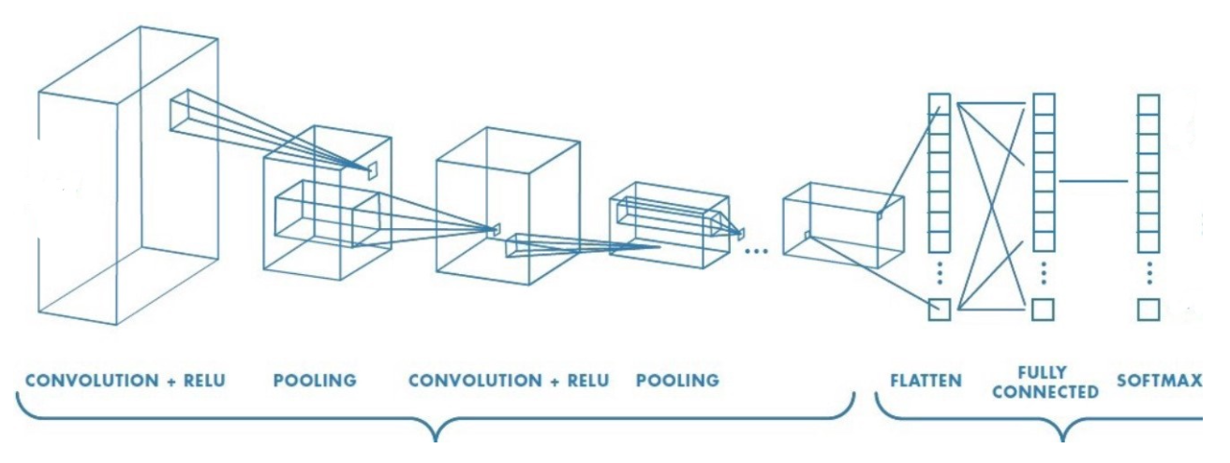
MODEL
Model should be small (so that it can be faster while predicting in real time)
lenet-5 model - one of the smallest CNN architecture with some minor modifications
An additional 3rd layer of CNN and a dropout of 0.6 with fully connected layer
Image of size (128,128,1) - will be able to capture features associated with both yawning and closed/Open eyes
No of epochs = 50 and use of Adam optimizer

Slide 6
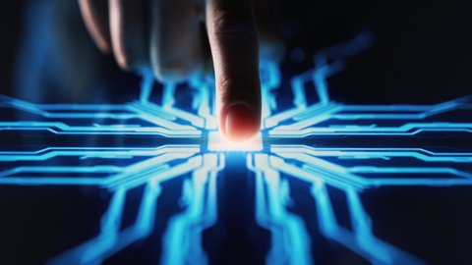

MODEL
SIMPLE LETNET
LENET WITH MODIFICATION
Relatively less no of trainable parameters
Training accuracy – 97%
Test accuracy – 91%
Optimizer – Adam
Epochs - 50
Over 3500K trainable parameters
Training accuracy – 98%
Test accuracy – 95%
Optimizer – Adam
Epochs - 50

Slide 7
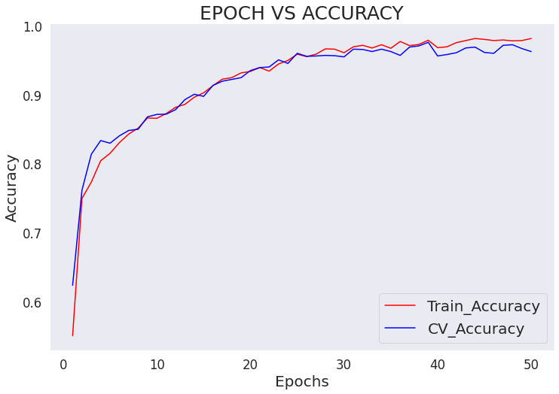
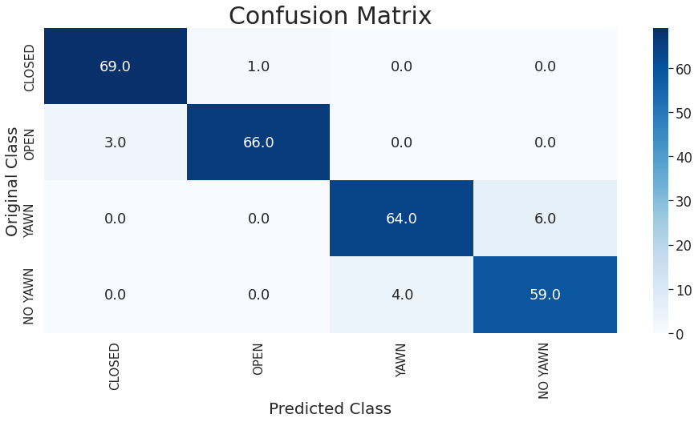
PERFORMANCE
Training accuracy of 98%, validation accuracy of 96% and test accuracy of 95%
No overfitting
No under-fitting

Slide 8
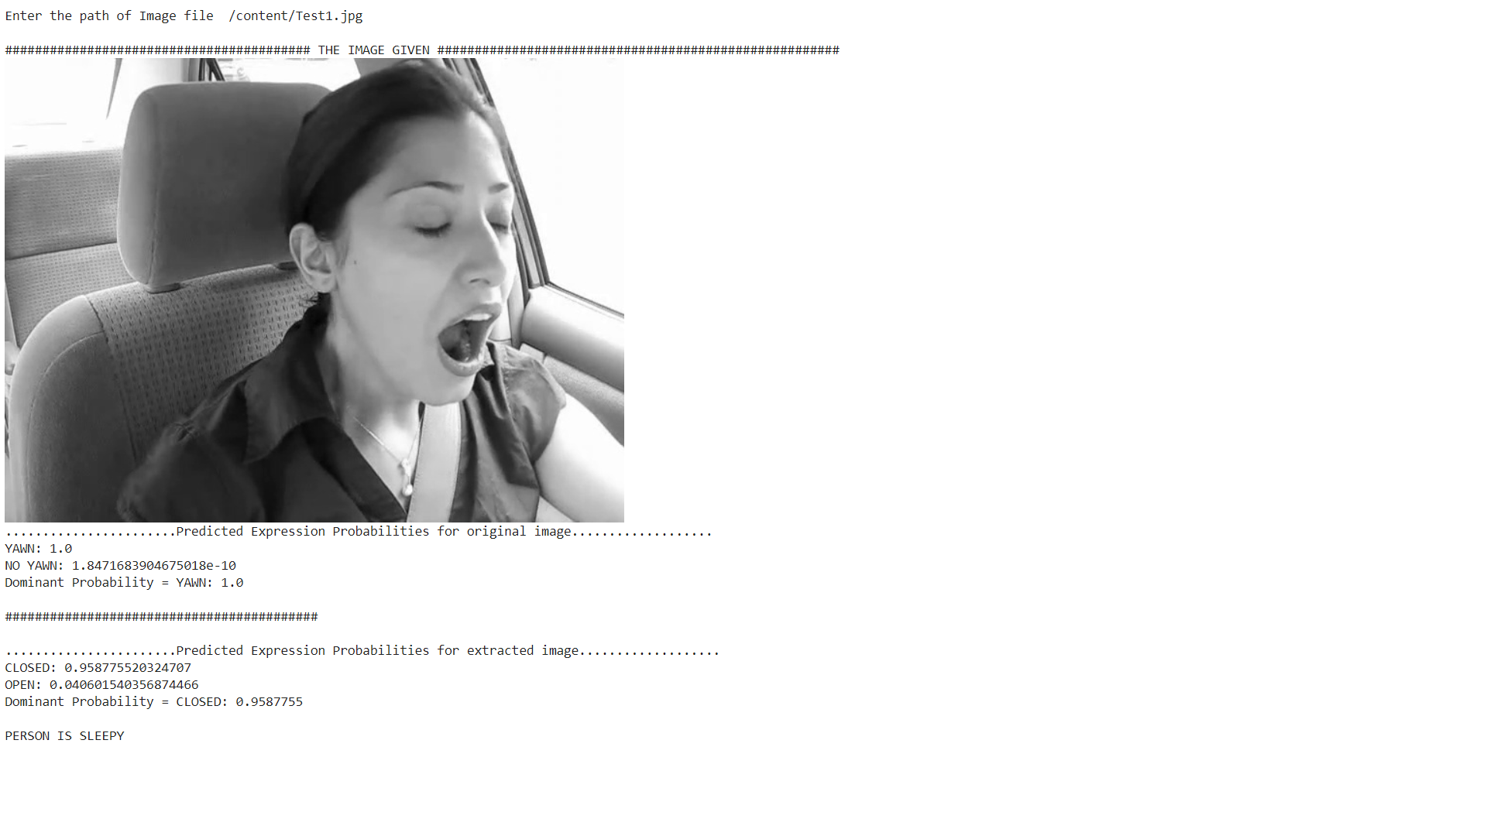
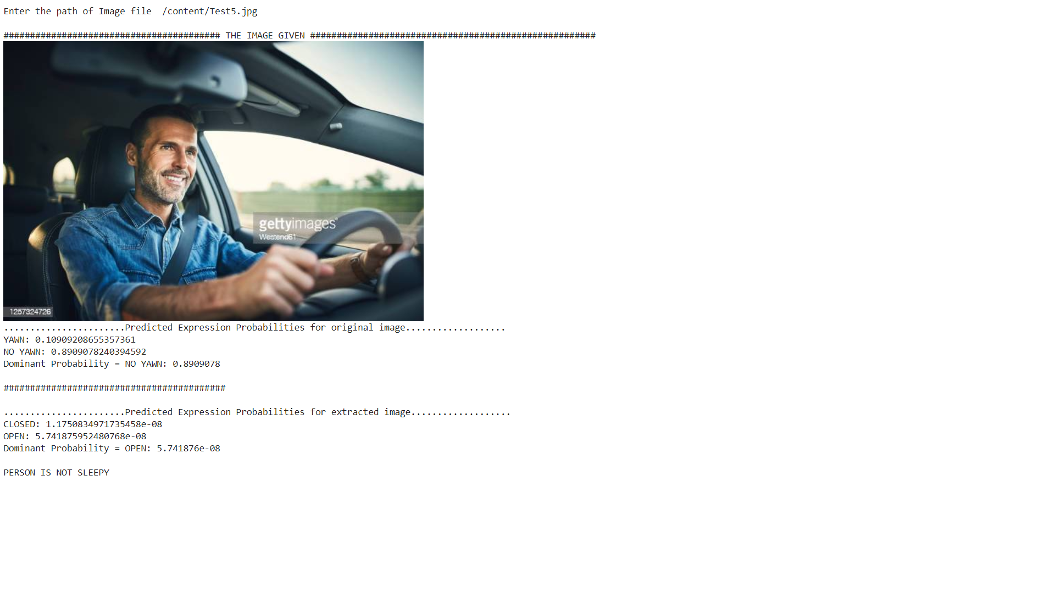
DETECTION WITH STILL IMAGES

Slide 9
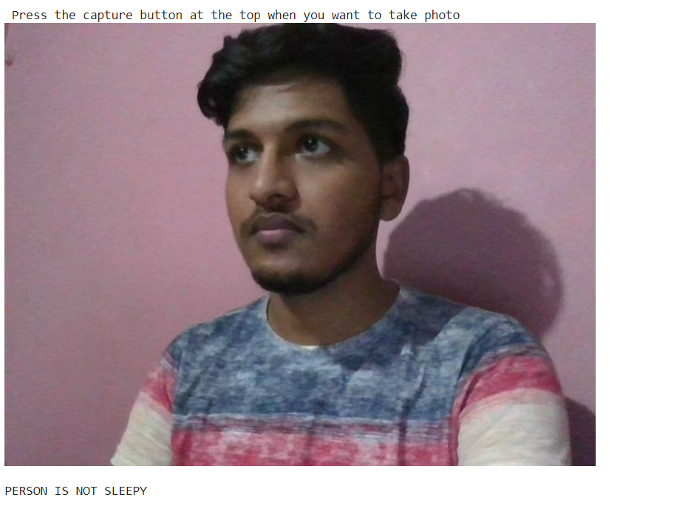
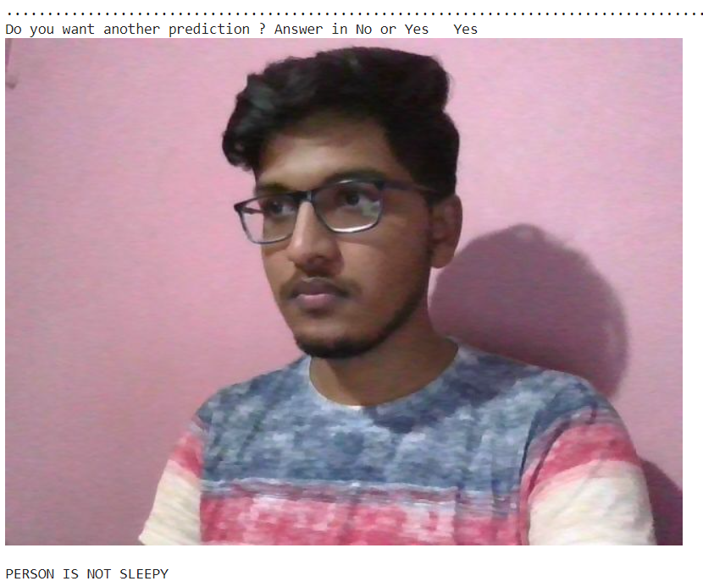
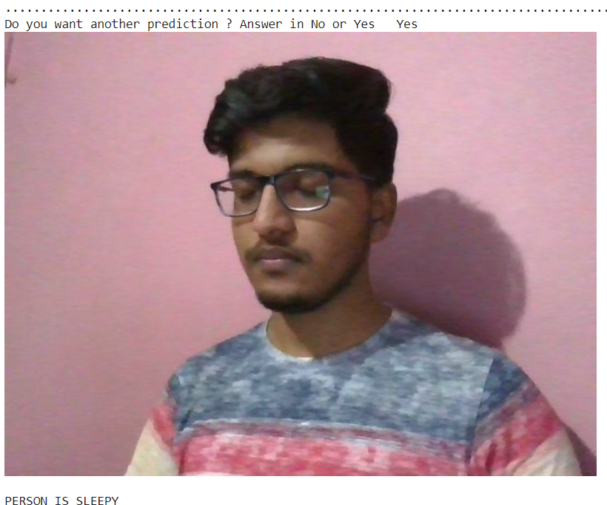
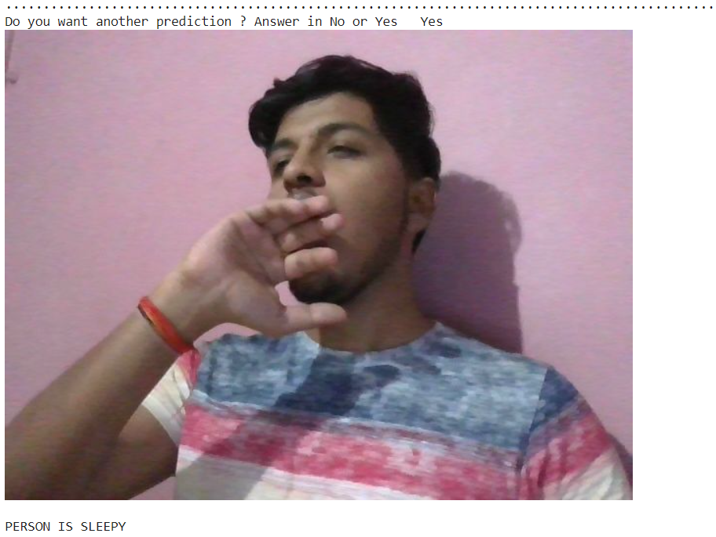
DETECTION WITH WEBCAM

Slide 10
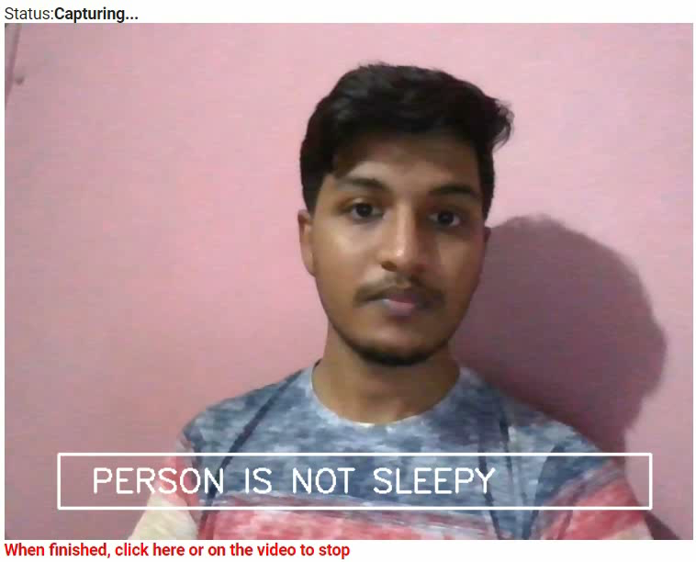
DETECTION IN REAL TIME

Slide 11

Thank you !

